Slide 1


Developed by:
Students of the Software Engineering Class and Dr. Donald Schwartz
Millsaps College, Jackson, MS, USA
Spring 2010 – Summer 2011
Presented by: Nicholas Handelman

Slide 2
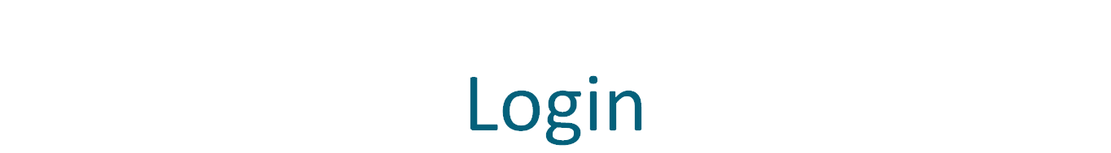
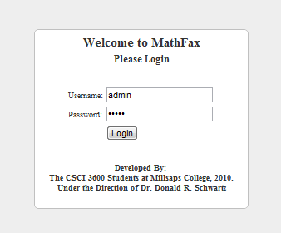

Slide 3
Administrators
Add and Delete Administrators
Manage Teachers
Manage Classes
Manage Students
View Results

Slide 4
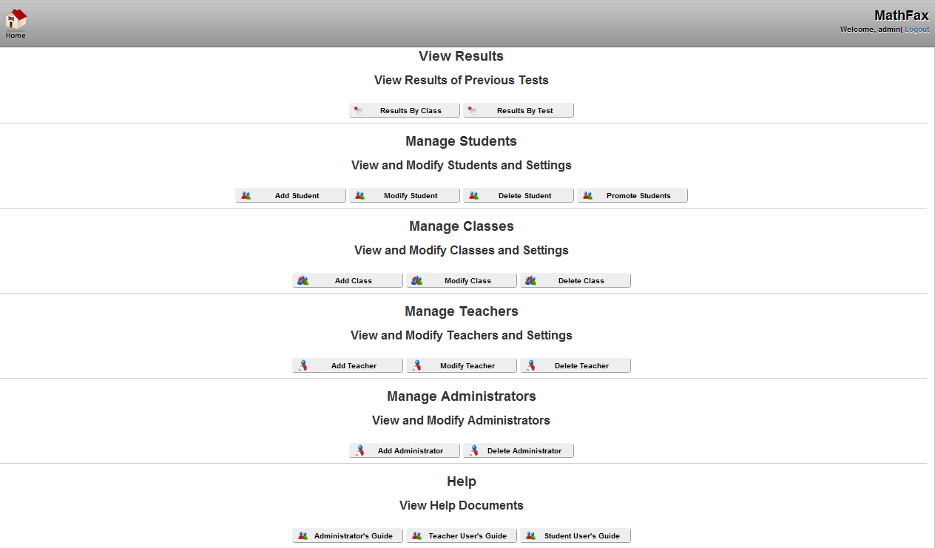

Slide 5
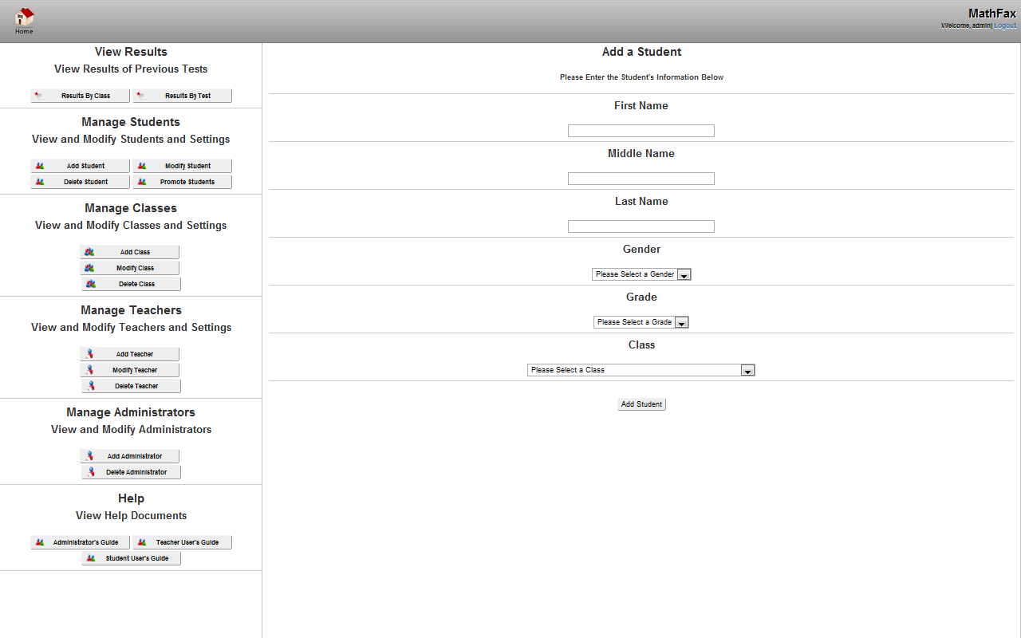

Slide 6
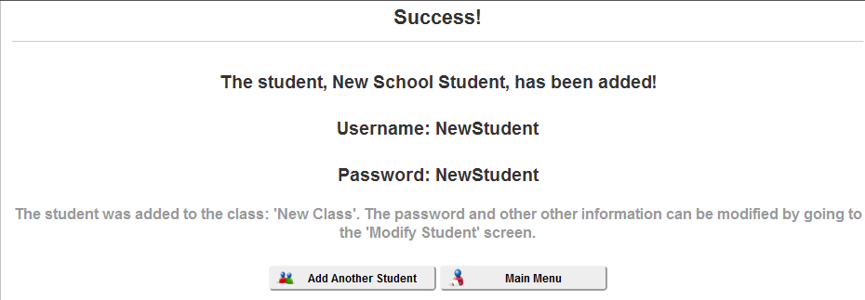
Add Student - Successful

Slide 7
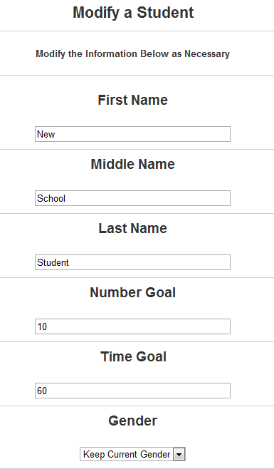
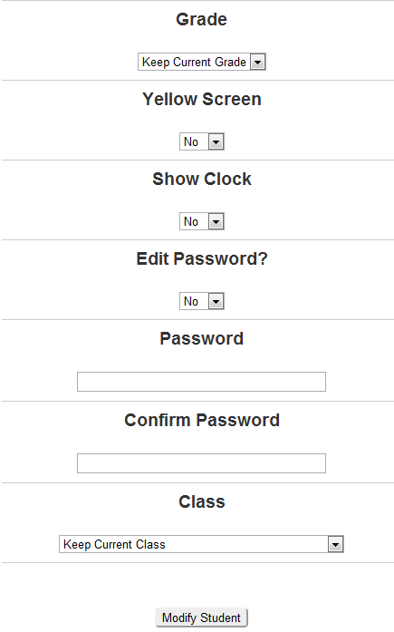
Modify Student

Slide 8
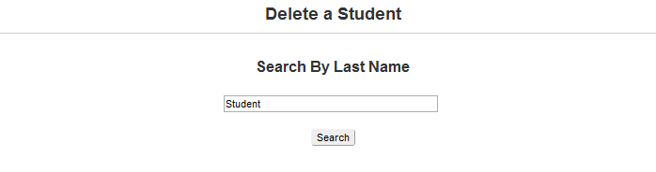
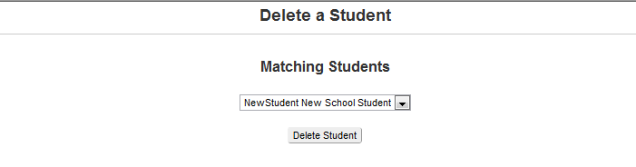
Delete Student
Step 1:
Step 2:

Slide 9
Teachers
Modify Students
Create Tests
Generate Tests
Assign Tests
View Results

Slide 10
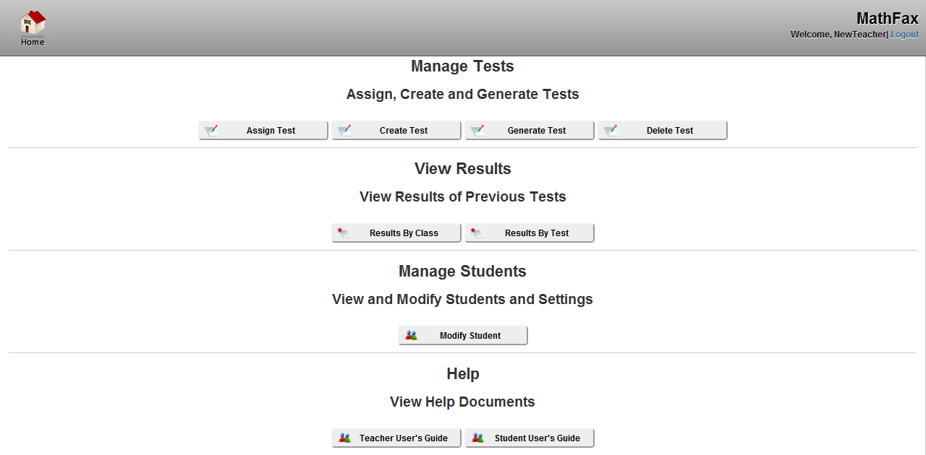

Slide 11
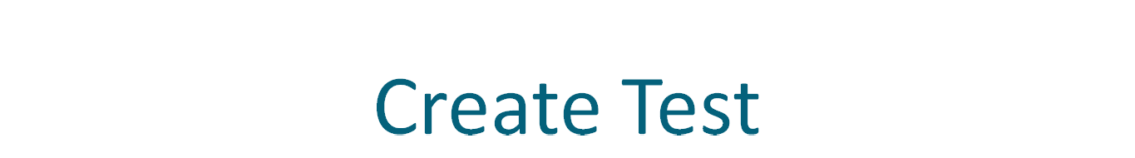
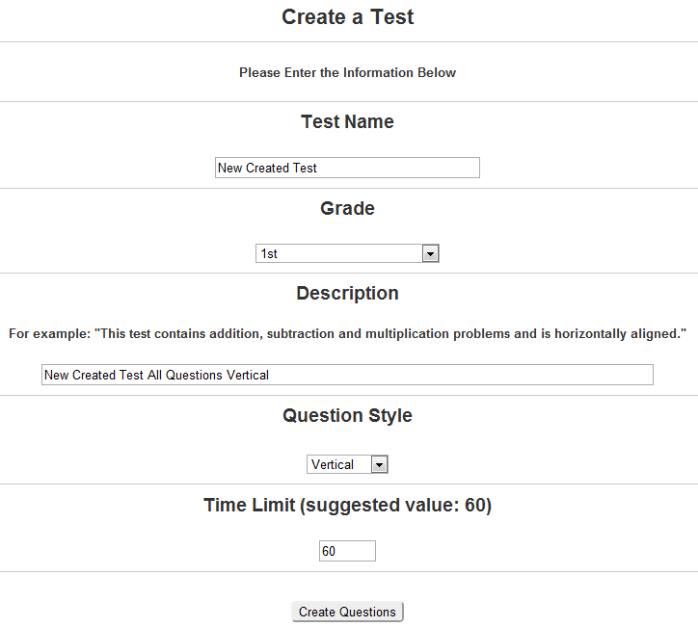

Slide 12
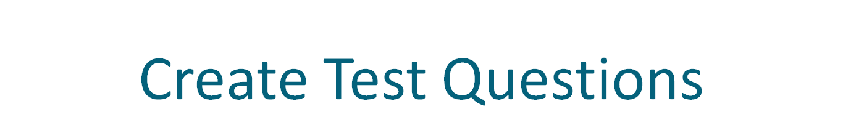
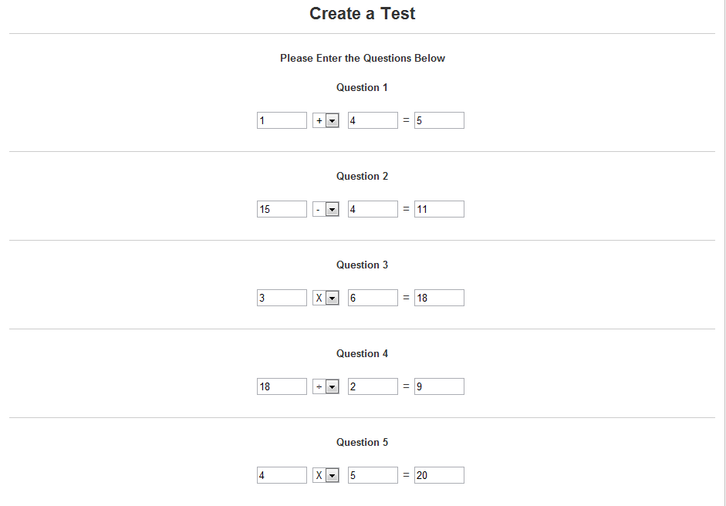

Slide 13
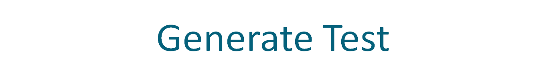
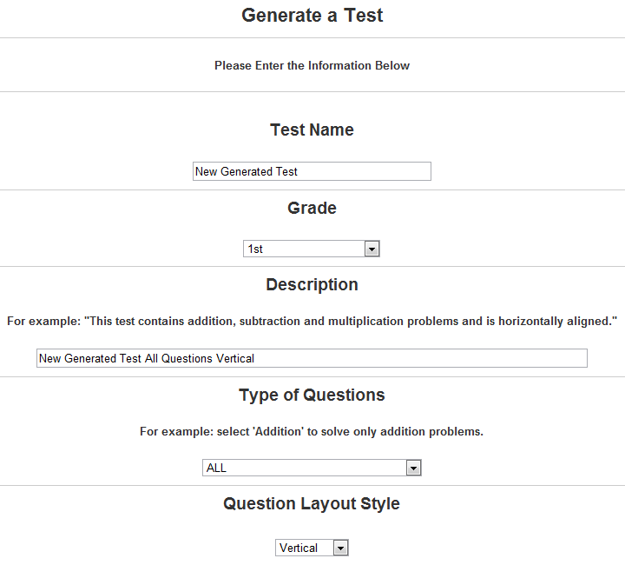
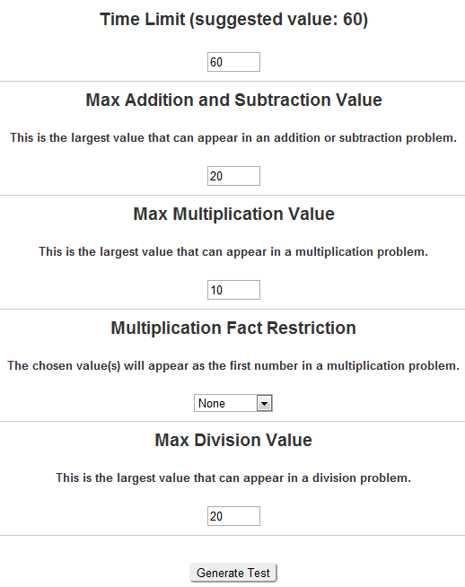

Slide 14
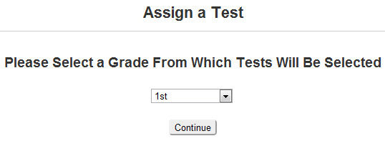
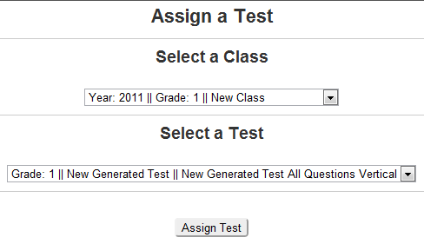
Assign Test
Step 1:
Step 2:

Slide 15
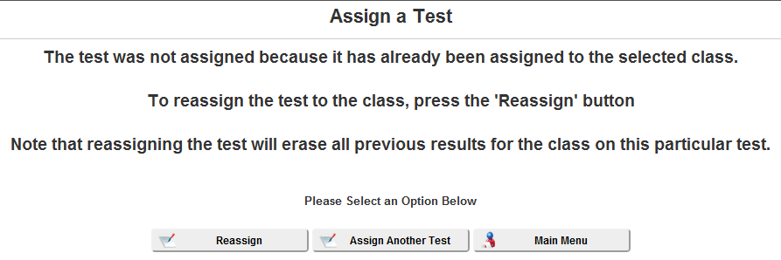
Reassigning a Test

Slide 16
Students
Take Test
Take Practice Test
See Goals
View Results

Slide 17
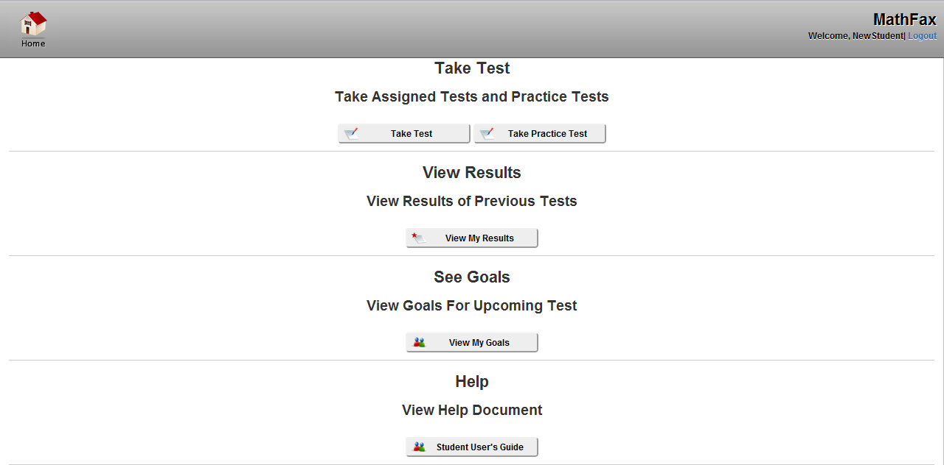

Slide 18
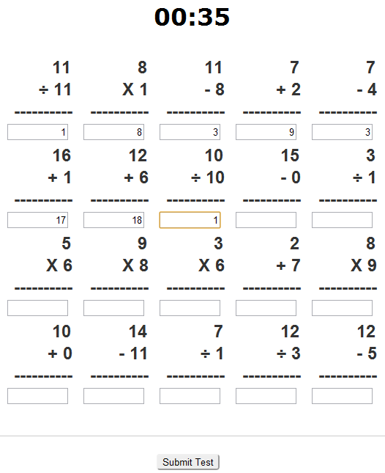
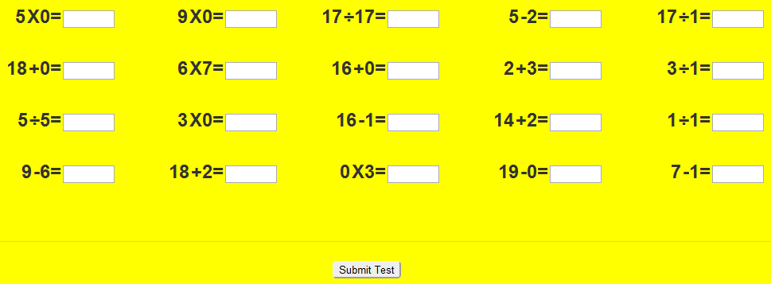
Example Test Screens

Slide 19
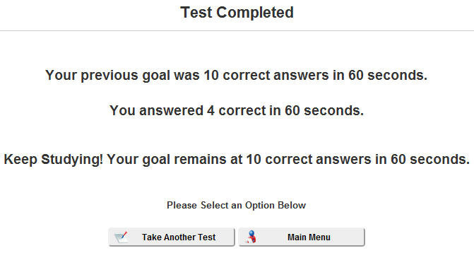
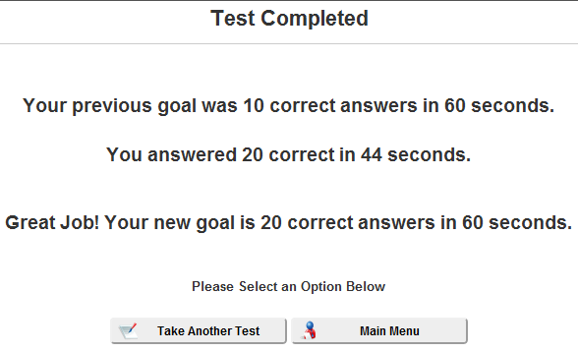
Example Test Completion Screens

Slide 20
View
Results
Textual Results
Visual Results

Slide 21
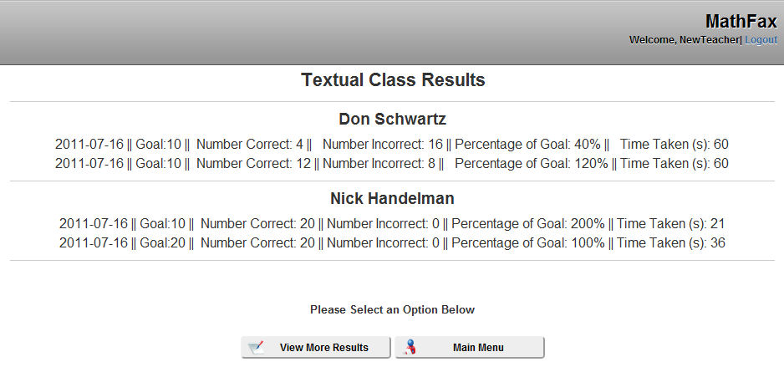
Textual Results

Slide 22
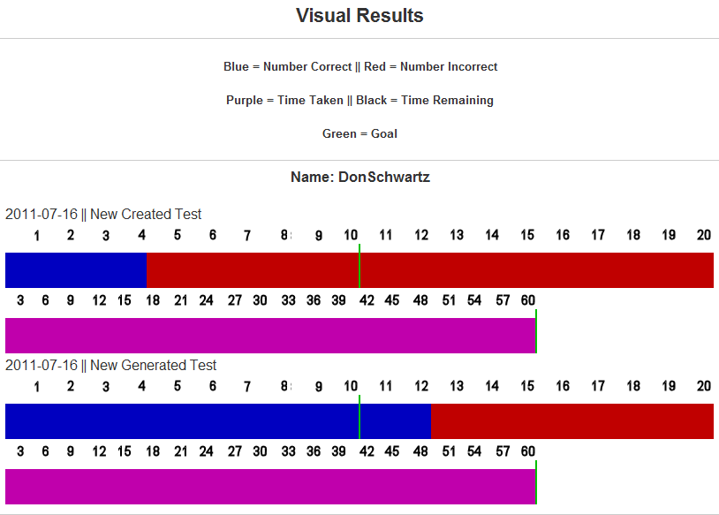
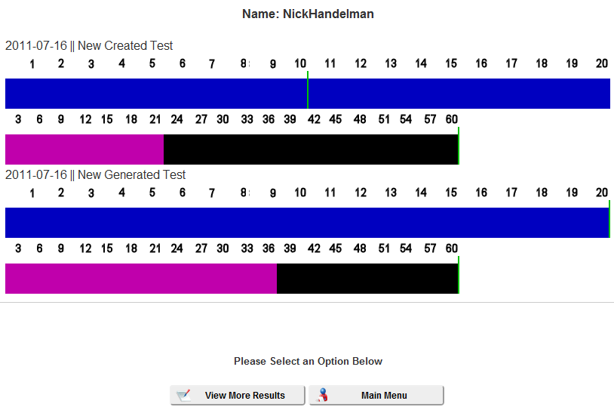
Visual Results

Slide 23
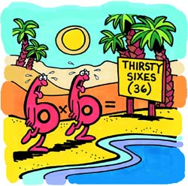
Questions or Comments?
Please contact Don Schwartz (schwadr@millsaps.edu) for information on obtaining this software.

